Slide 1
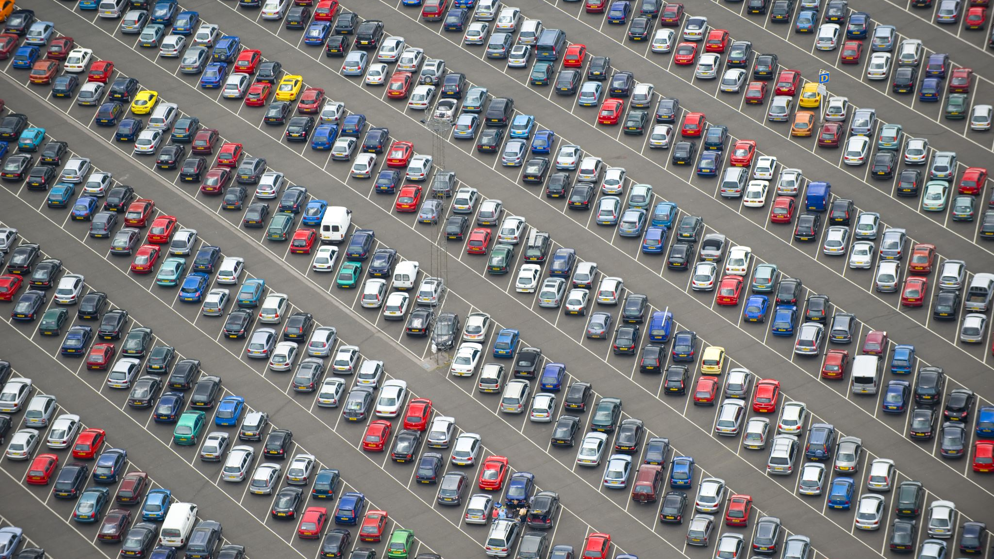
Kia Thefts
DSC640-T301 Data Presentation & Visualization
Joseph Damico

Slide 2
Protect our Cars
It’s time to re-evaluate current security measures and innovate car design to protect against the next generation of theft techniques. By identifying key theft trends, we can work together to build more secure vehicles and safeguard our customers.

Slide 3

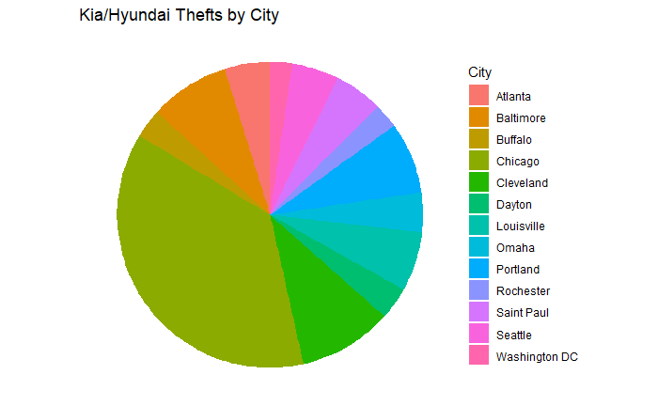
Theft by city
This chart shows car theft distribution across different cities. Chicago has the highest number of thefts (8,778), with other cities like Cleveland and Baltimore also having high numbers.

Slide 4
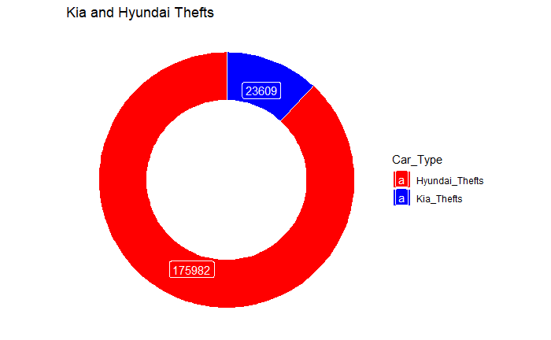
Hyundai vs Kia
This chart presents the thefts categorized by car type. There are far more Hyundai thefts (175,982) compared to Kia thefts (23,609), indicating a higher susceptibility for Hyundais.

Slide 5
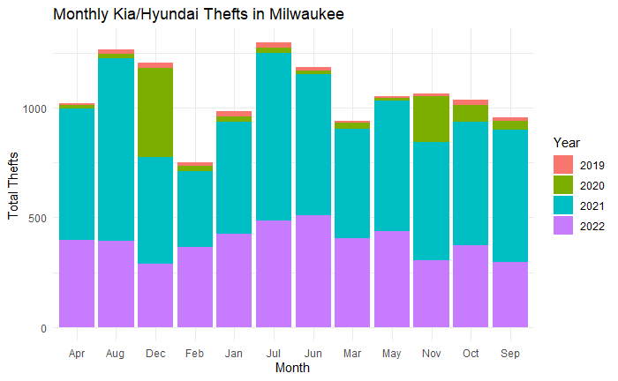
Milwaukee by month
The monthly breakdown of thefts shows a significant spike starting in 2021. April and August 2021 recorded massive thefts (with around 600–800 thefts), compared to the earlier years with fewer thefts.

Slide 6
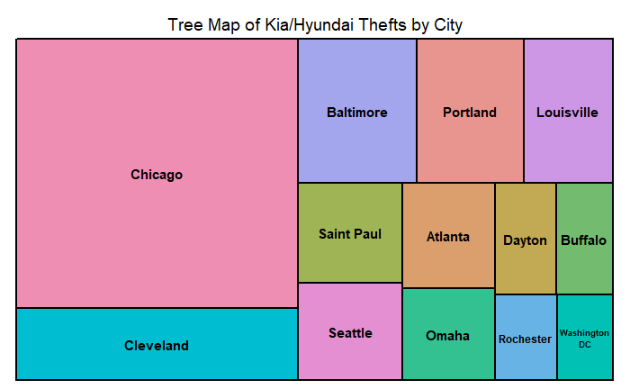
Where does this happen?
Similar to the pie chart, the tree map emphasizes that Chicago, Cleveland, and Baltimore dominate in terms of car thefts. It visualizes the proportion each city contributes to the total theft count.

Slide 7
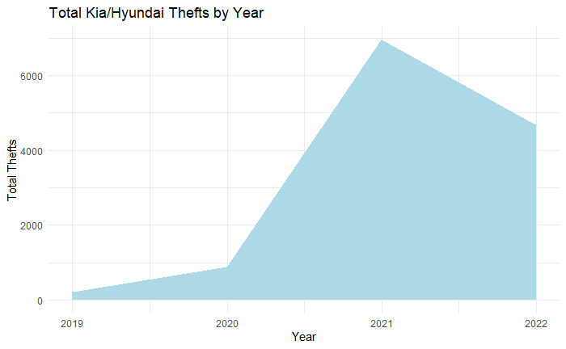
When did this start?
This chart shows theft growth over time. There’s a clear surge in 2021 and 2022, indicating a sharp rise in Kia and Hyundai thefts during these years.

Slide 8
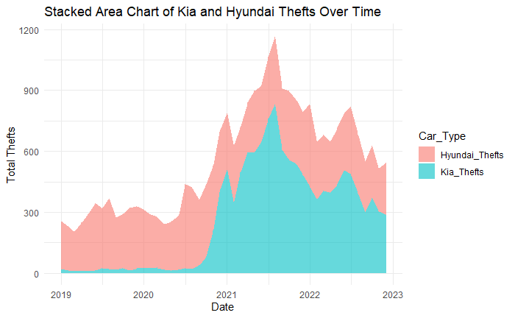
Hyundai vs Kia Theft increase
This chart breaks down the thefts by Kia and Hyundai over time. It visually confirms that Hyundai thefts have consistently been higher, with both seeing spikes from 2021 onwards.

Slide 9

LETS GO!!!!
The data shows a clear trend. Kia and Hyundai vehicles have become prime targets for theft, especially in certain cities. With theft rates rising sharply from 2019 to 2022, it’s crucial to prioritize security innovations. Addressing these vulnerabilities through enhanced design and technological improvements will not only reduce thefts but also restore trust in our vehicles. Now is the time to act! Let’s future-proof our cars and protect our customers.

